Slide 1
BME3053C Final Project
Sriharshith Akula, Angiolina Dall’Acqua, Ava Gueck, Aanya Manvi

Slide 2
Project Overview
Goal: Develop a system to decode and analyze EEG signals for extracting critical emotional information from brain function.
Use EEG data to identify and classify various emotional states:
Joy
Inspiration
Tenderness
Fear
Disgust
Sadness
Neutral
Train an SVM model to:
Compare brain responses to different stimuli.
Identify correlations between brain activation patterns and emotional states.
Notes:
No good way of analyzing multidimensional EEG data, to help diagnose neurological issues and improve fields like BCI, neuroengineering

Slide 3
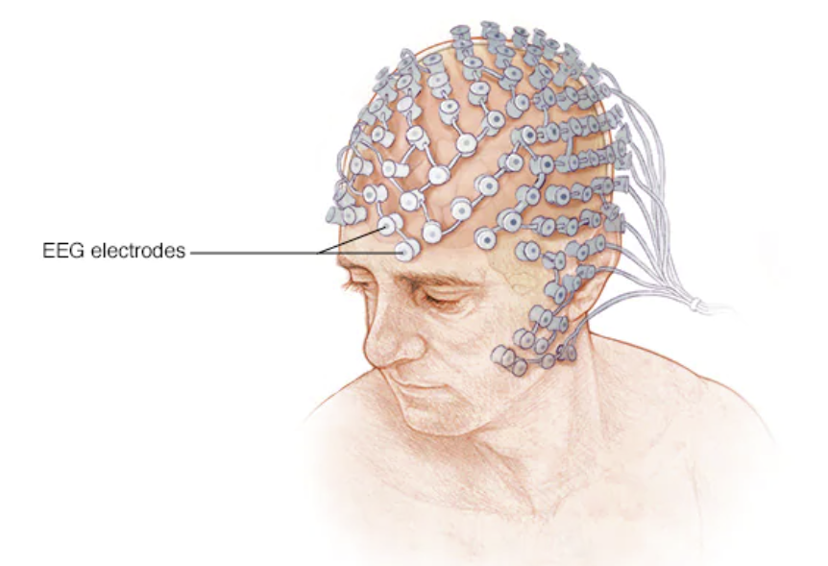
Biomedical Background - EEG
EEG (electroencephalogram)
record electrical activity of the brain
noninvasive neuroimaging technique
electrodes are placed on the head to record the voltage potentials due to the firing of neurons
Purpose: achieve a better understanding of the brain’s function

Slide 4
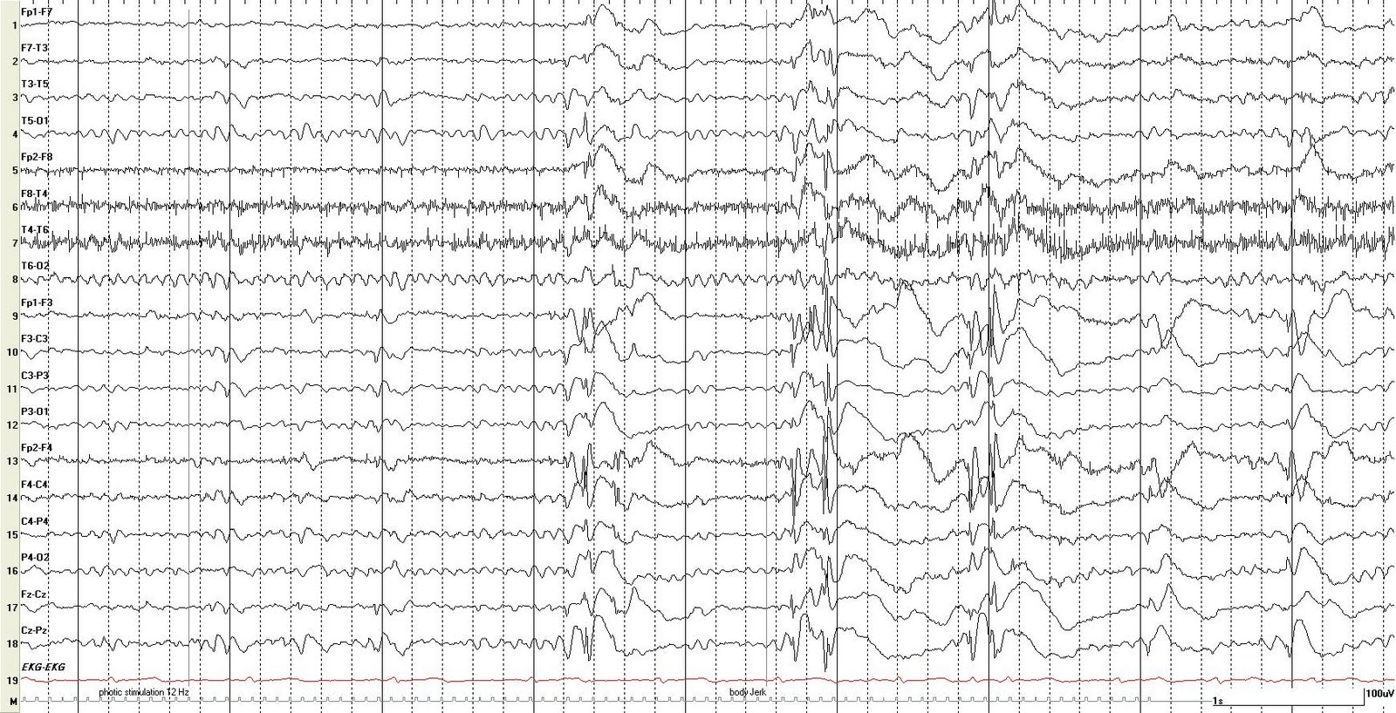
Example of EEG Data
Our EEG data was extracted from OpenNeuro
ONE Second of neural activity!

Slide 5
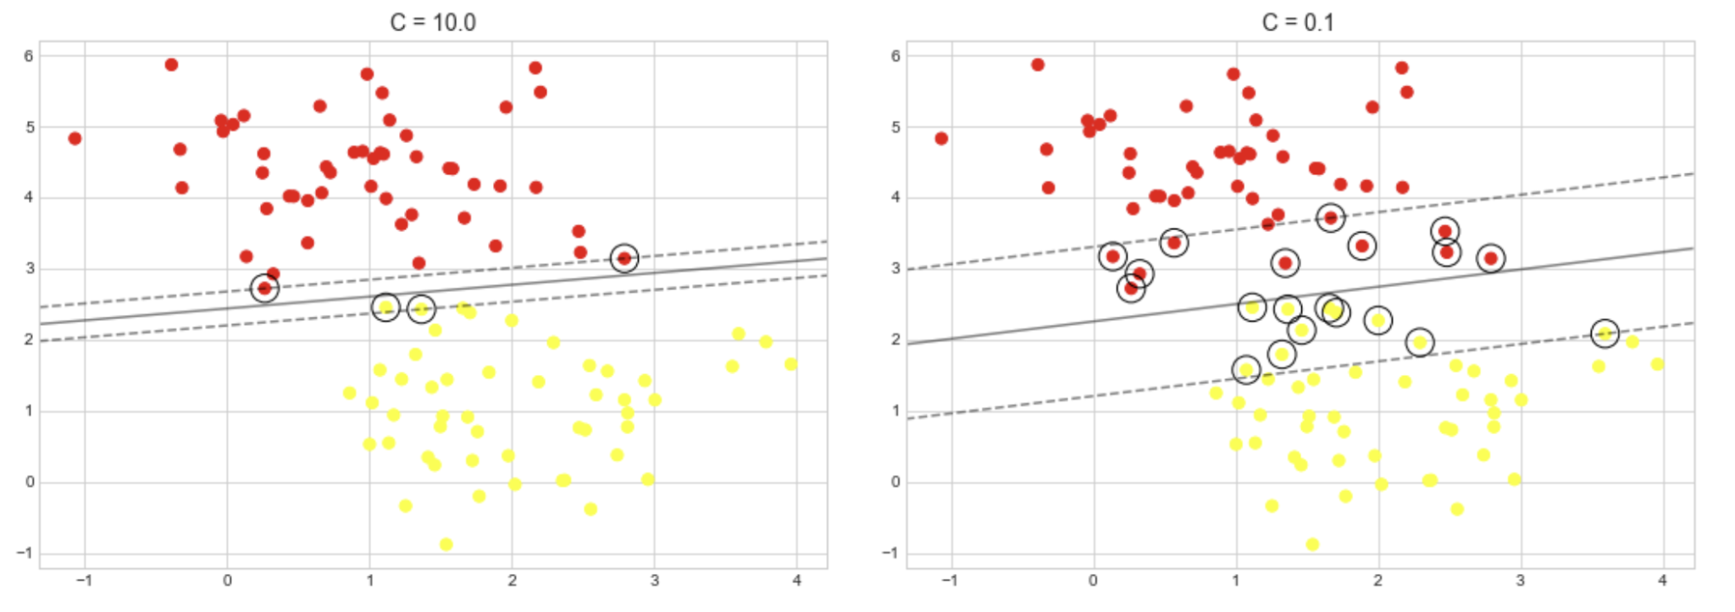
SVM - Support Vector Machine
A supervised machine learning algorithm for classification or regression.
Separates data into categories using support vectors to aid classification.
Key Process:
Transforms data using the kernel trick (through transformations of the data) to find optimal boundaries.
Handles nonlinear data with the tuning parameter C:
Smaller → Softer margins
Larger → Stricter margins

Slide 6
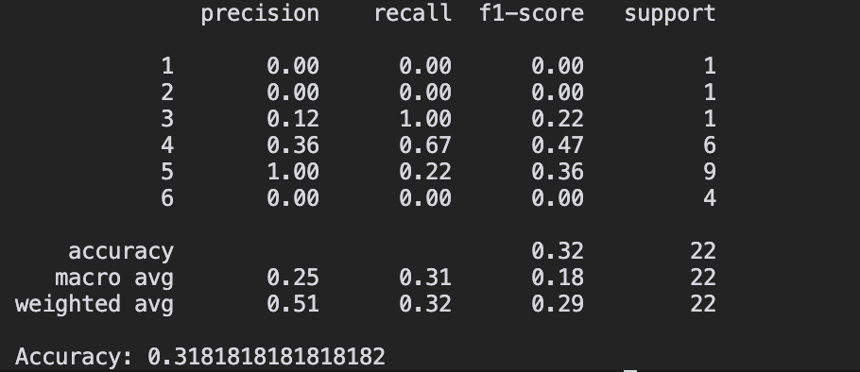
Results
Metrics:
Precision: Measures accuracy of positive predictions; low precision = many false positives.
Recall: Measures correct positive observations; low recall = missed predictions.
F1 Score: Harmonic mean of precision and recall; higher scores = balanced performance.
Support: Number of occurrences per class; impacts weighted average.
Sample Results (Subject 3):
Dataset Performance:
Weighted Average: 0.3642
Average F1 Score: ~0.36
Average Support Score: 32.3

Slide 7
Limitations
Technological Limitations
RAM Constraints:
Limited to 8 GB, preventing the ability to process 1 GB files simultaneously.
Data Imbalance:
High risk of overfitting the model to specific classes, reducing its ability to generalize across all categories.
Model Limitations
SVM Shortcomings:
Struggles with underrepresented classes, as it prioritizes differences in majority data over minority data.
Linear Kernel Usage:
Assumes linear relationships between variables, which is insufficient for analyzing the complex, nonlinear nature of EEG data.

Slide 8
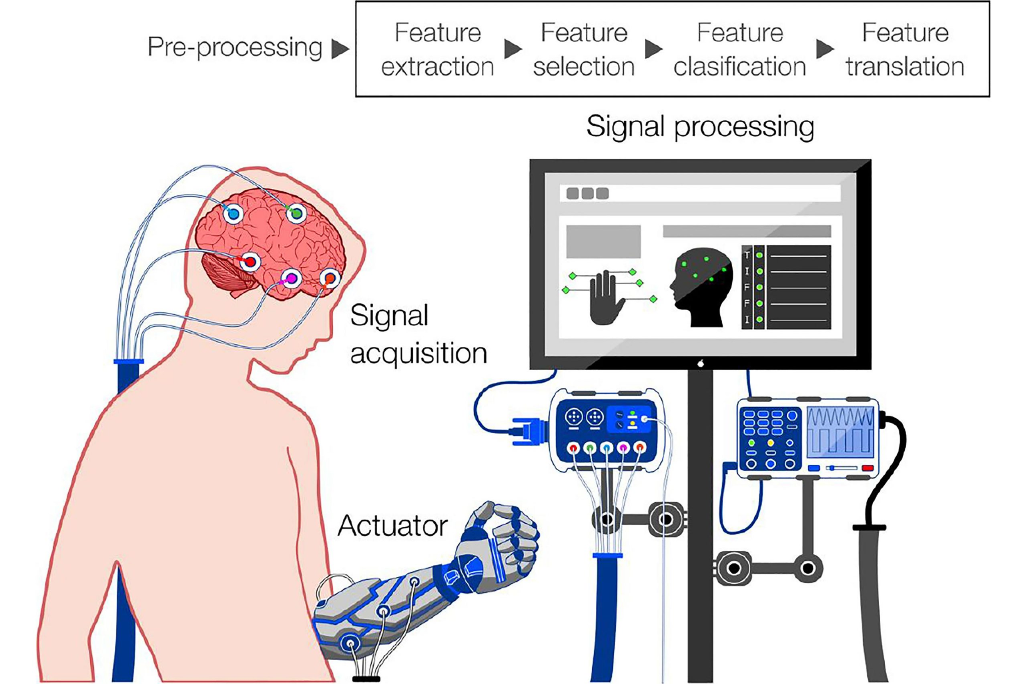
Significance
Uncovers relationships between brain activation patterns and specific emotions
Helps create more personalized interventions tailored to an individual’s unique neural patterns.
Supports development of therapies for emotional regulation and mental health disorders
Improves brain-computer interfaces (BCIs)
Makes Advances in AI and Neurotechnology

Slide 9

Biomedical Application
Rehabilitation for stroke victims can be revolutionized by using BCIs to…
help rewire neural pathways
restore motor function
allow patients to control robotic limbs or virtual avatars using their thoughts for repetitive practice of movements
have patients receive real-time feedback on their brain activity
Problem: A stroke can directly damage areas of the brain involved in emotions, making it difficult to adjust to life after a stroke

